Slide 1
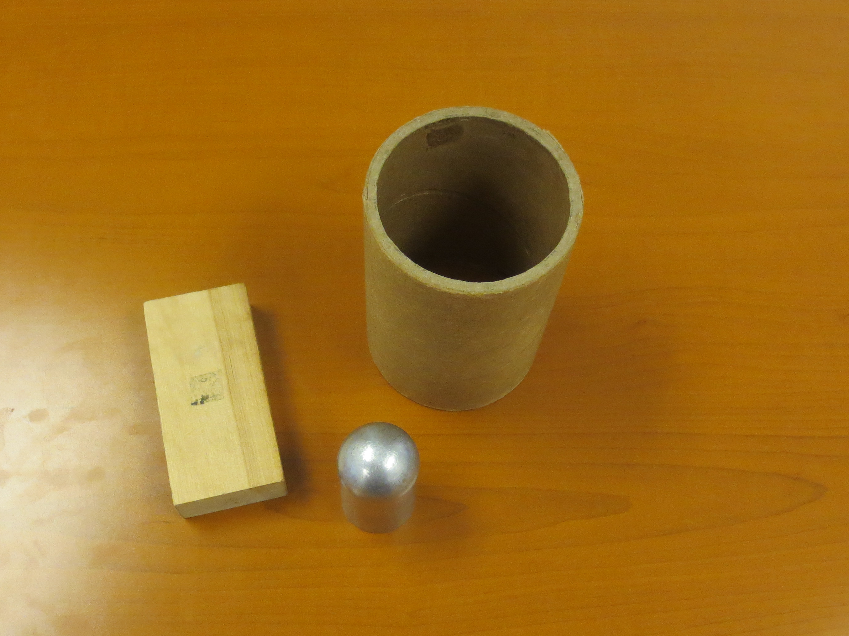
Lab: Error Propagation
Volumes

Slide 2
Significant Figures
The digits that are known accurately plus
the one estimated digit.
Rules for Identifying number
of significant figures
Nonzero digits are always significant:
Length =1.351 cm – (4 sig. fig).
Final or ending zeros written to the right of the decimal point are significant:
Length = 1.30 cm ( 3 sig. fig.)

Slide 3
Rules for Identifying number of significant figures
3. Zeros written between significant figures are significant:
Length = 1.03 cm (3 sig.fig.)
4. Zeros written to the right of the decimal point for the purpose of spacing the decimal point is not significant.
Mass = 0.005 kg = 5*10^⁻³ kg. (1 sig.fig.)

Slide 4
Vocabulary
Independent variable is a variable whose value determines the value of other variables.
Accuracy is the extent to which a given measurement agrees with the standard value for that measurement.
Average (Mean) is the sum of the measurements divided by the number of measurements.

Slide 5
Vocabulary
Uncertainty (standard deviation of the mean) in a stated measurement is the interval of confidence around the measured value such that the measured value is certain not to lie outside this stated interval.
Relative error/percent error/fractional uncertainty is an indication of how good a measurement is relative to the mean value of the quantity that is being measured.

Slide 6
Vocabulary
Precision – is the degree of refinement with which a measurement stated. It is the degree to which several measurements provide answers very close to each other.
Standard deviation describes the spread of values in the measurements. The standard deviation is a random quantity, it varies from measurement to measurement, but it stays the same on average when the sample size increases.

Slide 7
Vocabulary
Standard error is standard deviation of the mean that describes its accuracy as an estimate of the population mean. The standard error decreases as the number of the measurements , N, increases.
Error refers to the disagreement between a measurement and the true or accepted value.

Slide 8
Vocabulary
Systematic error is reproducible inaccuracy that is consistently in the same direction. All measurements fall above or below the "true value".
Random error is statistical fluctuations (in either direction) in the measured data due to the precision limitations of the measurement device.

Slide 9
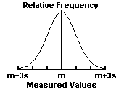
Vocabulary
Gaussian (Normal) Distribution - the familiar bell-shaped distribution. Simple
statistics assumes that random errors are distributed in this way.

Slide 10
Vocabulary
Propagation of Errors - the method of determining an uncertainty in a function of given independent variables variables each with an uncertainty.

